Slide 1
The Central Nervous System
Brain and spinal cord

Slide 2
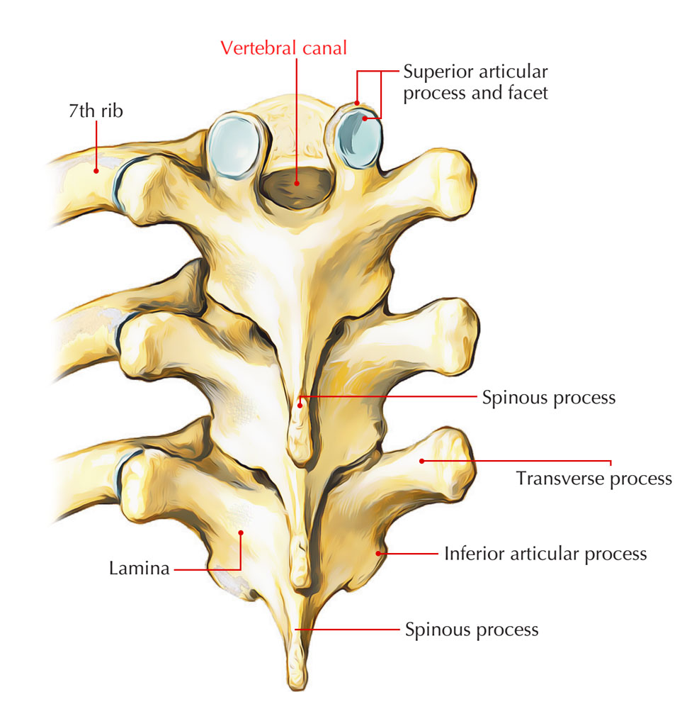
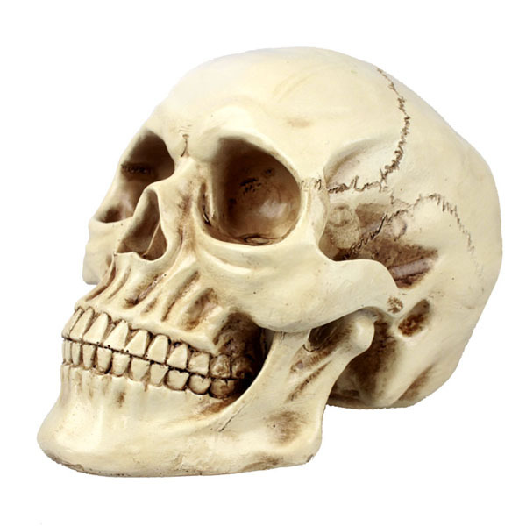
Protection of the nervous system Bone
Cranium - brain
Vertebral canal – spinal cord

Slide 3
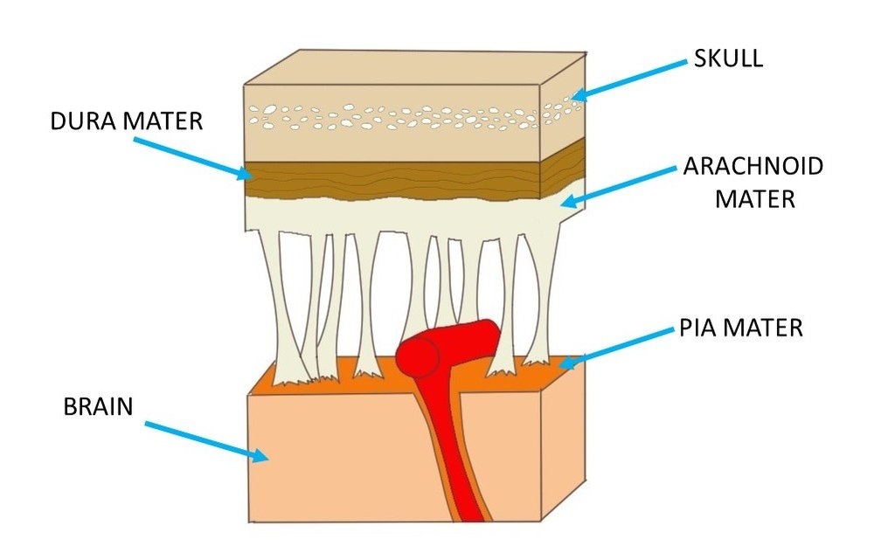
Protection of the nervous system Meninges
Three layers of connective tissue
Outer meningeal layer – is tough and fibrous
Middle meningeal layer – loose mesh of fibres
Inner meningeal layer – contains blood vessels stick closely to the surface of the brain and spinal cord

Slide 4
Protection of the nervous system Cerebrospinal fluid (CSF)
Occupies space between the middle and inner layer of meninges
Circulates through cavities in the brain and the central canal of the spinal cord
Clear watery fluid containing:
few cells, glucose, protein, urea, and salts
Protection: shock absorber
Support: the brain – suspended inside the cranium and floats in the fluid that surrounds it
Transport: Takes nutrients to CNS and carries wastes away

Slide 5
